Slide 1
Planning medical oxygen supply distribution to treat hospitalized COVID-19 infected patients
Thiago Berton Ferreira
thiago.ferreira96@edu.pucrs.br
Graduate Program in Computer Science – School of Technology Pontifical Catholic University of Rio Grande do Sul (PURCRS)

Slide 2
Agenda
Introduction
Formalization
Domain Description
Problem Description
Experiments and Results
Conclusion and Future Work

Slide 3
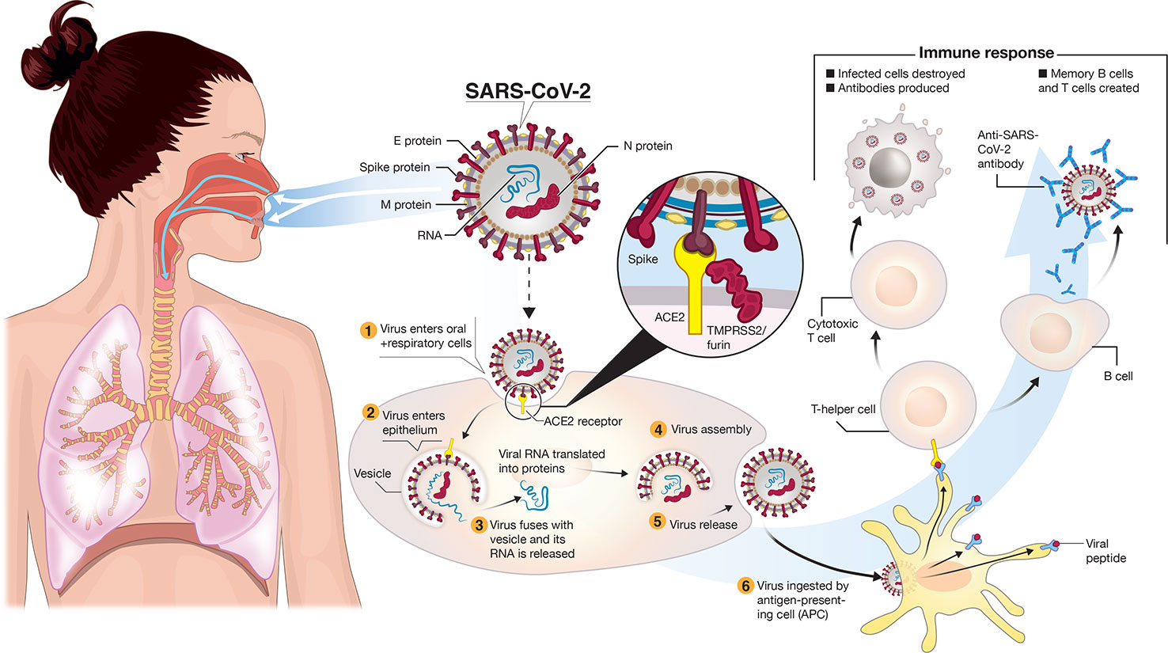
Introduction
The novel coronavirus disease (also known as COVID-19) is a highly infectious disease.
It is caused by the severe acute respiratory syndrome coronavirus 2 (SARS-CoV-2).
Transmitted through droplets generated when an infected person coughs, sneezes, or exhales.
Symptoms usually are fever, cough, headache, fatigue and breathing difficulties.
The most common cases are infection on the lungs causing pneumonia.
The lungs become filled with fluid and inflamed, leading to breathing difficulties.

Slide 4
Introduction
Modeling approaches have been developed to fight, in different ways, the COVID-19 pandemic.
For example, a framework were developed to assess the effectiveness of intervention strategies such as social distancing and mask use (IHME, 2020).
Also, Oliveira et al. (2021) estimate the number of beds required to attend the population in Bahia, Brazil based on the data from the first wave of COVID-19 in Brazil.
However, not a single model was developed for disaster response such as shortages of oxygen supply that was faced by hospitals cross several nations.
Objective: Developer a planner to estimate the minimal oxygen required in hospitals and the transportation logistic required to help avoid the collapse of health systems due to shortage of oxygen supply.

Slide 5
Formalization
Language: PDDL+
Dev. Environment/Planner: ENHSP
Search heuristic: A*
Heuristic: AIBR (Additive Interval-based relaxation)

Slide 6
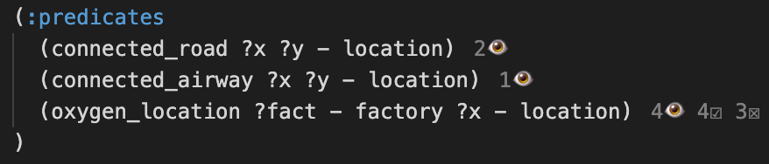
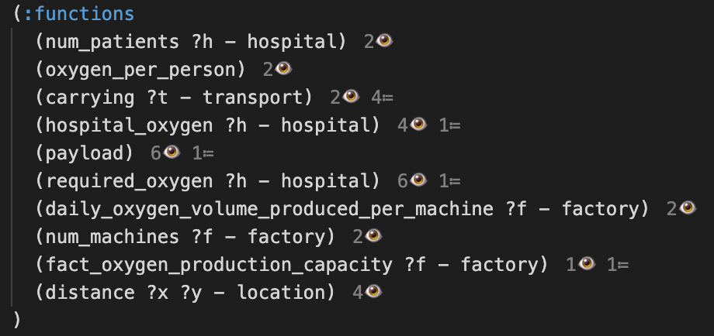
Domain Description
Predicates (3) and functions (10)

Slide 7
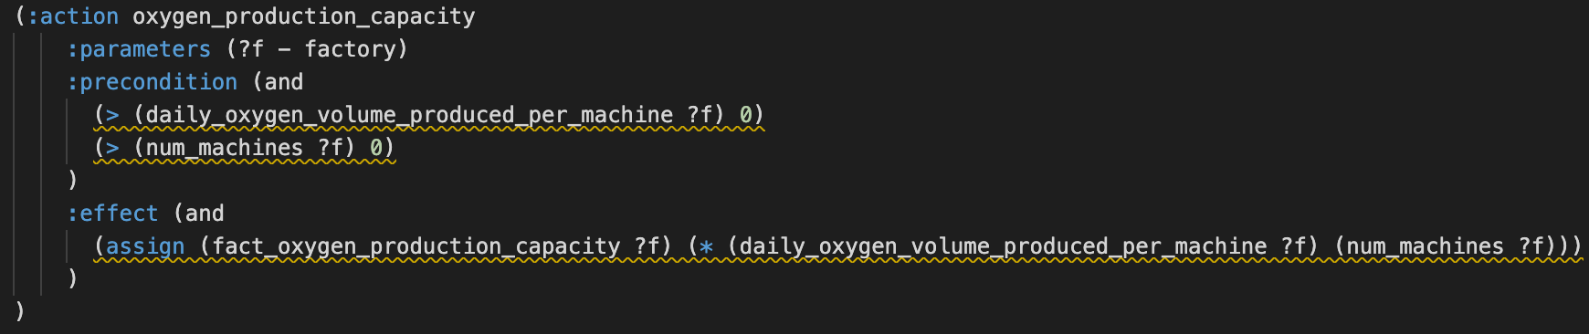
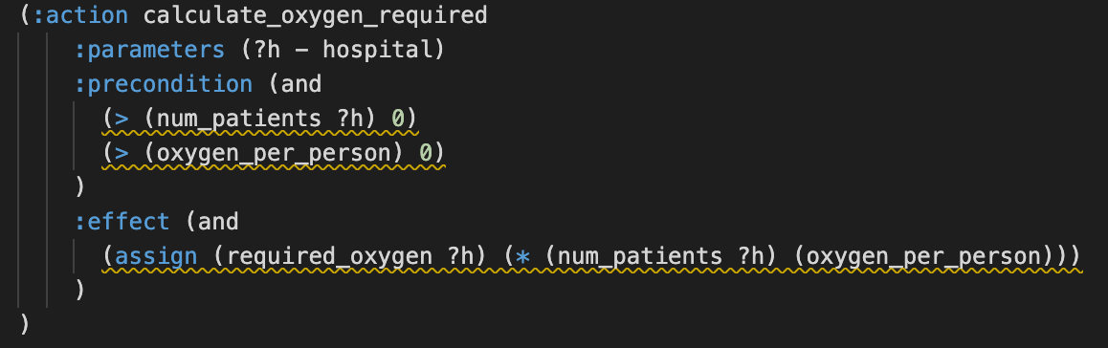
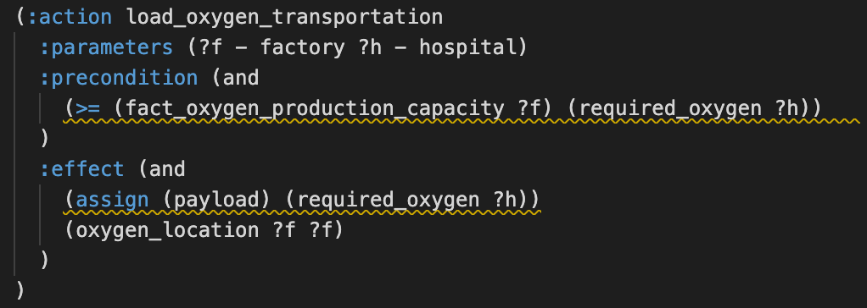
Domain Description
Actions (7)

Slide 8
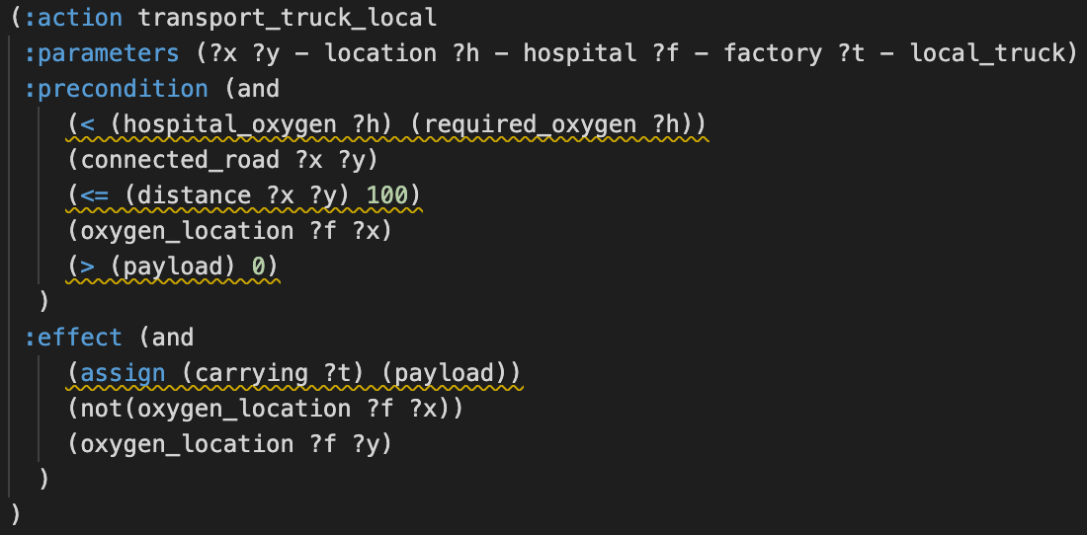
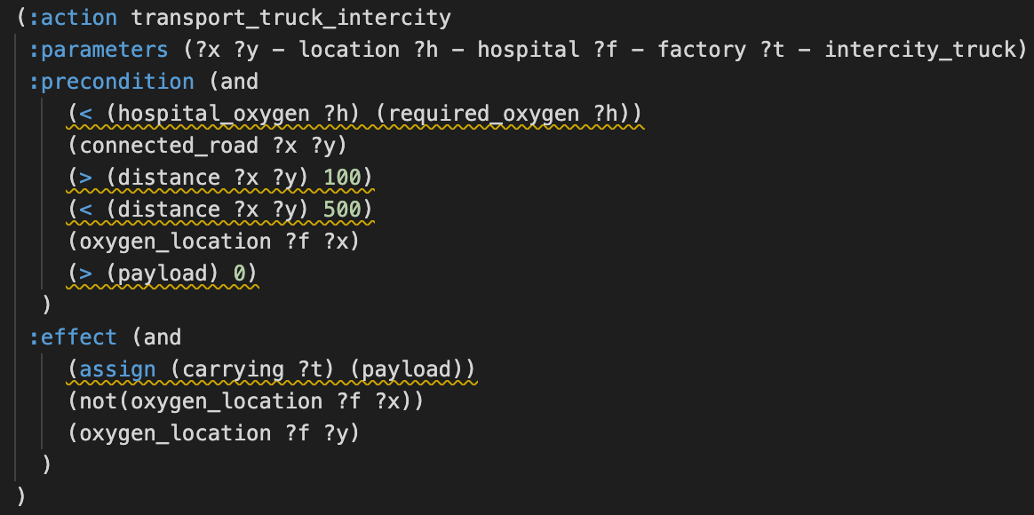
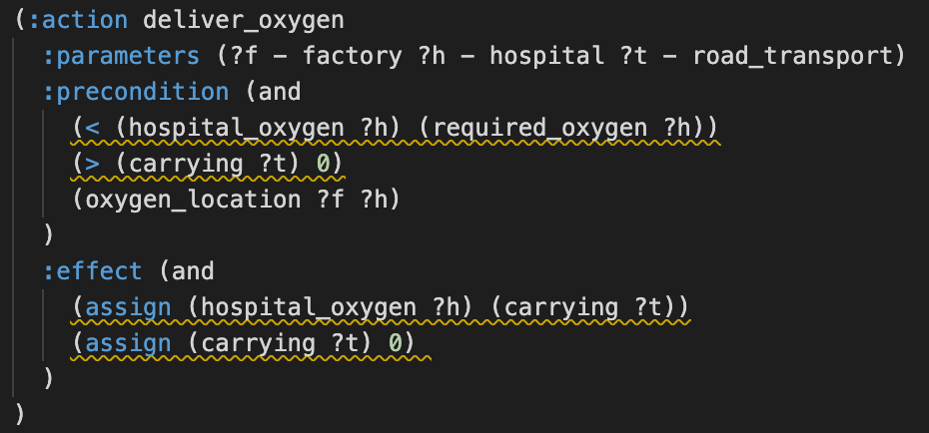
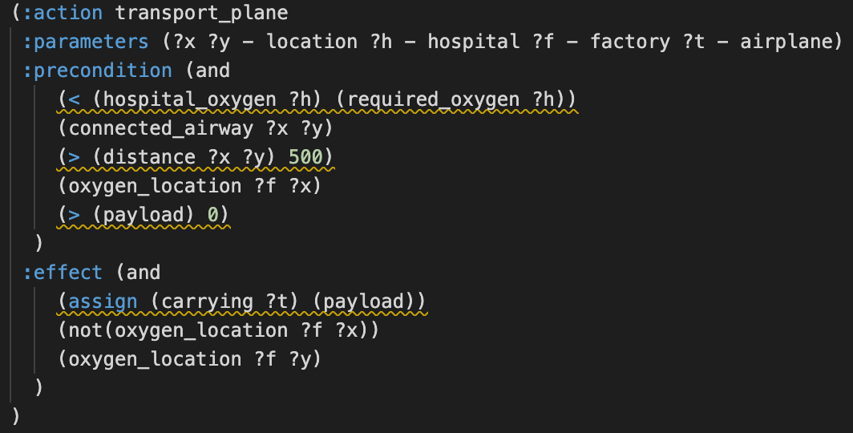
Domain Description
Actions (7)

Slide 9
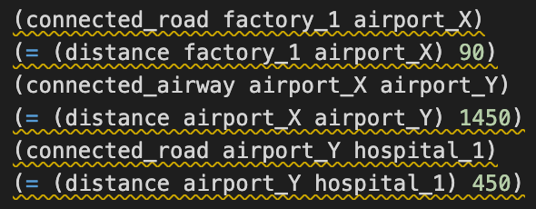
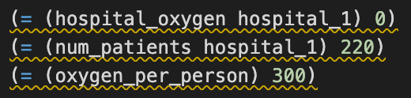
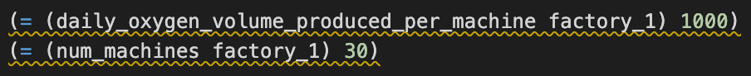
Problem Description
(:init)
Connections between entities
(Airways and roads)
Connections
Distance between entities (km)
Initial oxygen level on hospital
Hospital
Number of hospitalized patients
Oxygen consumed per patient
Daily production per machine
Factory
Number of machines

Slide 10
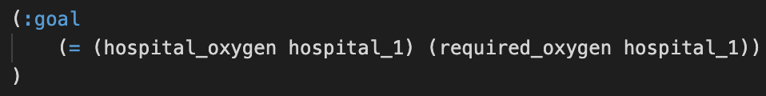
Problem Description
(:goal)
Two experiments were conducted to evaluate the developed planner.

Slide 11
Experiments and Results
Experiment 1
The first problem description was created to represent the situation of a single hospital in Manaus, Amazonas - Brazil in January 2021 that suffered with shortage of oxygen tanks.
The problem description was defined with:
One hospital (Hospital Universitário Getulio Vargas, Manaus);
Two airports (Brazilian air force base ALA8, Manaus and ALA9, Belém);
Two oxygen factories (White Martins factories in Manaus and Belém);
Roads and airways connections;

Slide 12
Experiments and Results
TIME:
0.02 seconds
Problem Solved
0.0: (oxygen_production_capacity White_Martins_Belem)
1.0: (calculate_oxygen_required Hospital_Universitario_Getulio_Vargas)
2.0: (load_oxygen_transportation White_Martins_Belem Hospital_Universitario_Getulio_Vargas)
3.0: (transport_truck_local White_Martins_Belem Air_Force_base_ALA_9-Belem
Hospital_Universitario_Getulio_Vargas White_Martins_Belem truck_local)
4.0: (transport_plane Air_Force_base_ALA_9-Belem Air_Force_base_ALA_8-Manaus
Hospital_Universitario_Getulio_Vargas White_Martins_Belem C-130_Hercules)
5.0: (transport_truck_local Air_Force_base_ALA_8-Manaus
Hospital_Universitario_Getulio_Vargas Hospital_Universitario_Getulio_Vargas White_Martins_Belem truck_local)
6.0: (deliver_oxygen White_Martins_Belem Hospital_Universitario_Getulio_Vargas truck_local)

Slide 13
Experiments and Results
Experiment 2
A hypothetical scenario was developed to analyze a broader and more complex environment.
This problem description consists of:
One small-size factory in Porto Alegre, RS – Brazil;
One large-scale factory in São Paulo, SP – Brazil;
Hospitals in Rio Grande do Sul including Passo Fundo, Carazinho, and Marau;
Two airports (Porto Alegre and São Paulo) connected through airways and the roads connecting these entities.
Hospitals in Passo Fundo, Carazinho, and Marau had a relatively small oxygen demand while the hospital in Porto Alegre had a significantly larger request.

Slide 14
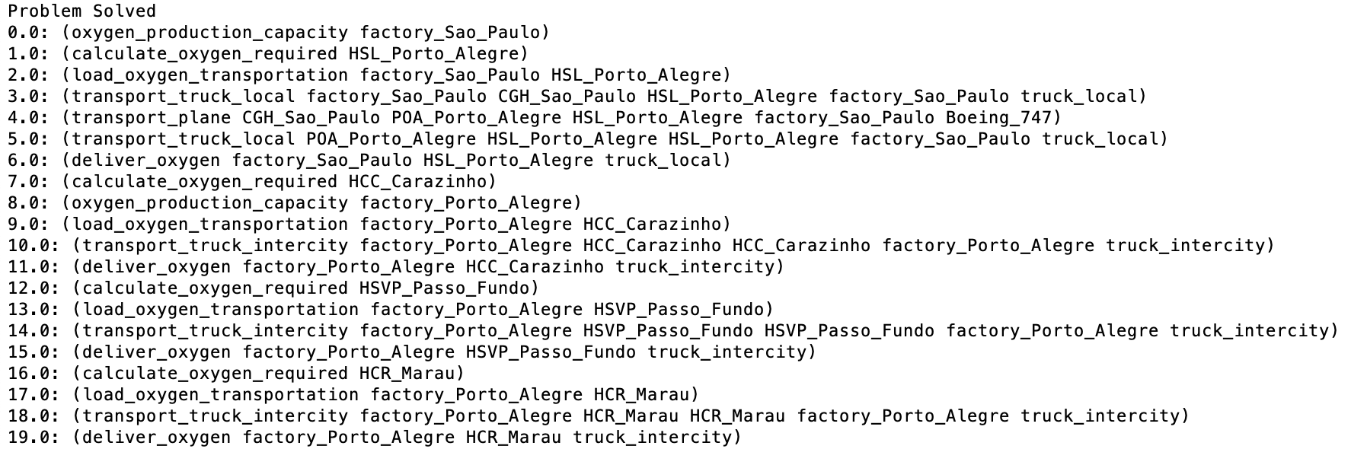
Experiments and Results
TIME:
0.34 seconds

Slide 15
0.0: (oxygen_production_capacity factory_Sao_Paulo)
1.0: (calculate_oxygen_required HSL_Porto_Alegre)
2.0: (load_oxygen_transportation factory_Sao_Paulo HSL_Porto_Alegre)
3.0: (transport_truck_local factory_Sao_Paulo CGH_Sao_Paulo HSL_Porto_Alegre factory_Sao_Paulo
truck_local)
4.0: (transport_plane CGH_Sao_Paulo POA_Porto_Alegre HSL_Porto_Alegre factory_Sao_Paulo
Boeing_747)
5.0: (transport_truck_local POA_Porto_Alegre HSL_Porto_Alegre HSL_Porto_Alegre factory_Sao_Paulo
truck_local)
6.0: (deliver_oxygen factory_Sao_Paulo HSL_Porto_Alegre truck_local)
7.0: (calculate_oxygen_required HCC_Carazinho)
8.0: (oxygen_production_capacity factory_Porto_Alegre )
9.0: (load_oxygen_transportation factory_Porto_Alegre HCC_Carazinho )
10.0: (transport_truck_intercity factory_Porto_Alegre HCC_Carazinho HCC_Carazinho factory_Porto_Alegre
truck_intercity)
11.0: (deliver_oxygen factory_Porto_Alegre HCC_Carazinho truck_intercity)
12.0: (calculate_oxygen_required HSVP_Passo_Fundo)
13.0: (load_oxygen_transportation factory_Porto_Alegre HSVP_Passo_Fundo)
14.0: (transport_truck_intercity factory_Porto_Alegre HSVP_Passo_Fundo HSVP_Passo_Fundo
factory_Porto_Alegre truck_intercity)
15.0: (deliver_oxygen factory_Porto_Alegre HSVP_Passo_Fundo truck_intercity)
16.0: (calculate_oxygen_required HCR_Marau)
17.0: (load_oxygen_transportation factory_Porto_Alegre HCR_Marau)
18.0: (transport_truck_intercity factory_Porto_Alegre HCR_Marau HCR_Marau factory_Porto_Alegre
truck_intercity)
19.0: (deliver_oxygen factory_Porto_Alegre HCR_Marau truck_intercity)
Hospital Porto Alegre
Hospital Carazinho
Hospital Passo Fundo
Hospital Marau

Slide 16
Conclusion and Future Work
This study is an initial step for estimating the demand for oxygen supply in hospitals and healthcare facilities to help avoid oxygen shortages.
Ideally, this planner can be used to minimize the risks of health system collapse due to the shortages of oxygen for medical oxygen therapy.
The scalability of the developed planner allows the definition of problems that can variate according to the area of study.
Future work will incorporate into the source code the transportation capacity for each transportation method.
Additionally, explore specific scenarios in which some transportation methods may not be available.

Slide 17
Planning medical oxygen supply distribution to treat hospitalized COVID-19 infected patients
Thank you!

